Slide 1
A Project of BRICKS GAME
Presented by:
1.MD.HADIUZZAMAN (170201065)
2. MD.NAZIMUZZAMAN (170201045)
3.MD. TORIKUL ISLAM (170201067)
4. Mrinmoy Ray (170201073)
Submitted to:
Fatima Jahan Sarmin
Lecturer
DEP OF CSE

Slide 2
start
If
Choice==1
Yes
If game over
Play game
No
No
If
Choice==2
If
Choice==2
No
Get point
Yes
Thank you and
Good by
See instruction
End

Slide 3
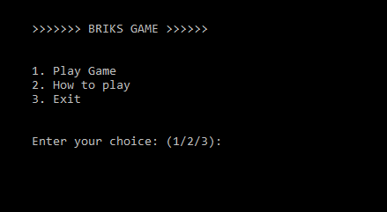
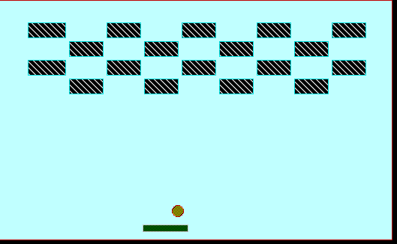
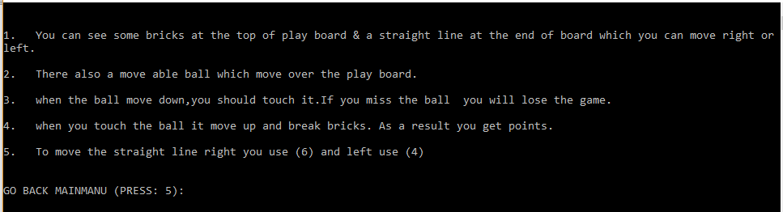

How to structured we bricks game
Main Menu
Play Game How To Play Exit

Slide 4

How to coded we bricks game
Used three basic header files :
1 . <stdio.h>
2. <stdlib.h>
3. <graphics.h>
4. < Conio.h>

Slide 5





Used simple if conditions for deciding moves.
Used go to for jumping between codes.
Used system(“CLS”); for clearing console screen and that why we used < Stdlib.h > header file.

Slide 6
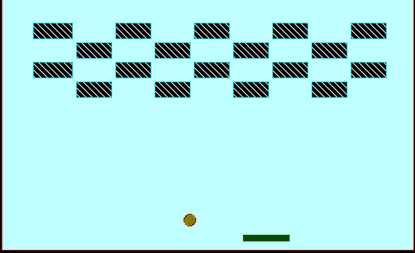
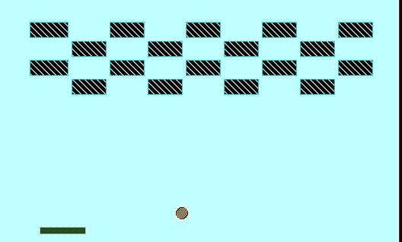
Function Explanation:
Screen();
We added graphics in code blocks and then we draw our game window.
Then we draw some bricks in the selected window .
At the last of window we draw a moveable rectangle which is controlled by user.

Slide 7





A ball also draw which is randomly moved in the selected
window .

Slide 8

Limitations in Our bricks game:
1. The moves have to be inserted by keyboard strokes. Input by mouse
click is not supported.
2. When the game will start, at first you must move the window in the
center of screen.
3. The program we’ve written is only playable against a bot. Versus
mode was not included.
4.The difficulty level of the game is neither hard nor easy.

Slide 9
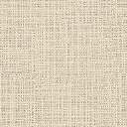

Thank You !!
1. It was our first project in university life and the first
game we programmed.
2. It was really fun and educative to complete this project .
3. We are thankful to our beloved and respected Fatima
Jahan Sarmin mam that she allowed us to work on bricks
game.

